Slide 2
Tableau + Python = ❤
Larry Clark
Scott King
(he/him/his)
Strategic Sales Consultant
Sales Consultant
Tableau Software
Tableau Software

Slide 3
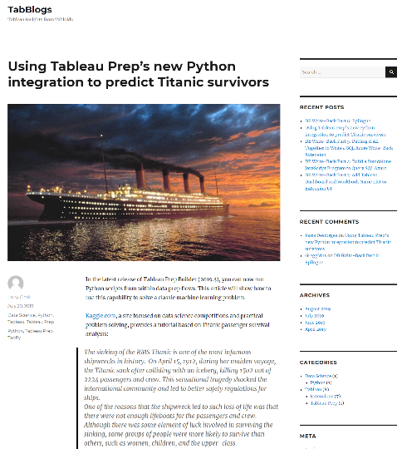


Your Presenters
Larry Clark
Strategic Sales Consultant
Microsoft background
Tabblogs.com & github.com/tabblogs
Austin, TX
Scott King
Advanced Analytics Board Member
Author of "Learning Hadoop 2" video training by Packt
Not an actual king
Woodstock, Georgia

Slide 4
Agenda
Why use Tableau and Python together?
Installing Python and TabPy
Connecting Tableau Desktop to TabPy server
Adding a Python script as a Tableau calculation in Tableau Desktop
Using functions deployed to TabPy
Connecting to TabPy from Tableau Prep Builder
Running Python scripts from Tableau Prep Builder

Slide 5
Why use Tableau and Python together?

Slide 6
Python
IEEE #1 programming language in 2019
Easy to learn
Fast to program
Clear syntax
Solid documentation
One of the largest ecosystems of data analysis tools, web frameworks and testing tools of any language
Cross platform
Calculated Field: SCRIPT_X(…)
TabPy
Python Return Value
Notes:
https://www.fullstackpython.com/why-use-python.html
https://medium.com/@mindfiresolutions.usa/python-7-important-reasons-why-you-should-use-python-5801a98a0d0b

Slide 7
TabPy
Tableau’s external Python service
Lightweight enough to deploy on developer’s desktop
Secure via secure sockets layer (SSL) as of 2019.2
Useable in three ways:
Calculation in Tableau Desktop or Server
Call deployed function from Tableau Desktop or Server
Python script called from Tableau Prep Builder & Conductor

Slide 8
What’s Possible: Demos
Calculating Correlation Coefficients (using Jupyter)
Credit Scoring
Principal Component Analysis
Forecasting

Slide 9
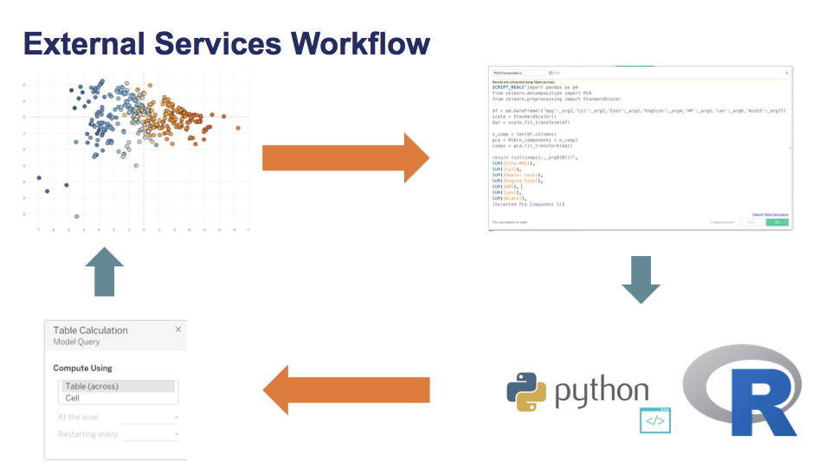

Slide 10
Installation

Slide 11
Installing Python
One option for installing Python is to download from https://www.python.org/downloads/
Instead, we will use the Anaconda Distribution because it includes Python as well as Jupyter Notebook and a full ready-to-go data science platform
Anaconda is already installed on our lab machines
To install on Anaconda on your own device:
Download the Anaconda distribution with Python 3.x from https://anaconda.com/distribution
Install the Anaconda distribution by running the appropriate installation executable for your platform (Anaconda3-2019.**-Windows-x86_64.exe on Windows) from the downloads directory

Slide 12
Installing TabPy
Open an Anaconda command prompt
pip install virtualenv
Create a Python environment: virtualenv tc19tabpy
To activate the environment: tc19tabpy/Scripts/activate
pip install tabpy
Notes:
To install TabPy on to an environment, pip (the Python package installer) needs to be installed and updated first:
python -m pip install --upgrade pip
Now TabPy can be install as a package:
pip install tabpy
To start TabPy with default setting run the following command:
tabpy
https://github.com/tableau/TabPy/blob/master/docs/tabpy-virtualenv.md

Slide 13
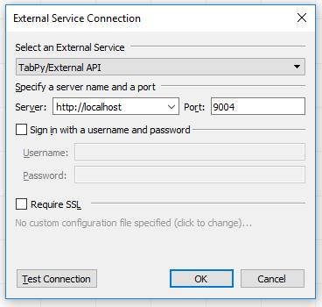
Connecting Tableau Desktop to TabPy
To connect Tableau Desktop to your TabPy server:
Select the Help menu, then select Manage External Service Connection
Plug in the server name or ip address of the machine on which TabPy is running; in this case, "localhost" since it's running on this machine
Plug in the port number (9004) that you observed when you started TabPy

Slide 14
Authoring a Tableau Calculation with an Embedded Python Script

Slide 15
Authoring a Tableau Calculation with an Embedded Python Script
Tableau can pass a Python script to TabPy through one of four functions:
SCRIPT_INT
SCRIPT_REAL
SCRIPT_STR
SCRIPT_BOOL
Choose the function based on the return data type.
Reference "Using Python in Tableau Calculations" here: https://github.com/tableau/TabPy/blob/master/docs/TableauConfiguration.md

Slide 16
Example: append two strings
SCRIPT_STR("
lst= []
for i in range(0,len(_arg1)) :
lst.append(_arg1[i]+', '+_arg2[i])
return lst
",
ATTR([Country]),ATTR([Region])
)

Slide 17
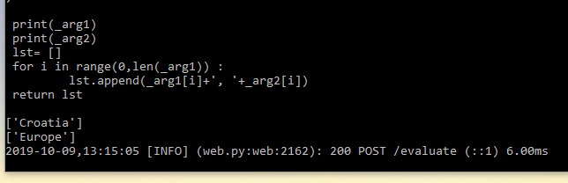
Debugging Embedded Scripts
SCRIPT_STR(“
print(_arg1)
print(_arg2)
lst= []
for i in range(0,len(_arg1)) :
lst.append(_arg1[i]+', '+_arg2[i])
return lst
",
ATTR([Country]),ATTR([Region])
)
Python print statements will print to the console. Works best with a local instance of TabPy.

Slide 18
Lab Exercise: Analyze the Correlation of Discount and Profit
SCRIPT_REAL(" print(_arg1)
print(_arg2)
import numpy as np
return np.corrcoef(_arg1,_arg2)[0,1]"
,SUM([Discount]),sum([Profit])
)

Slide 19
Using Deployed Functions

Slide 20
Using Deployed Functions
TabPy Tools documentation covers in detail how functions can be deployed as endpoints. You can invoke such endpoints using tabpy.query option by specifying the endpoint name and arguments and retrieving the response object.
A SCRIPT calculated field in Tableau using the “add endpoint” defined in TabPy Tools documentation could look like the following:
SCRIPT_REAL("
return tabpy.query('add',_arg1,_arg2)['response']",
-SUM([Discount]),SUM([Price]))

Slide 21
Publishing Functions to TabPy Server
Sample code is in the Principal Component Analysis sample: /tabpy/models/scripts/pca.py
from tabpy_tools.client import Client
connection = Client(‘http://localhost:9004/')
connection.set_credentials(user, passwd)
connection.deploy('PCA', PCA,
'Returns the specified principal component.',
override=True)
print("Successfully deployed PCA")
Notes:
https://github.com/tableau/TabPy/blob/master/docs/tabpy-tools.md

Slide 22
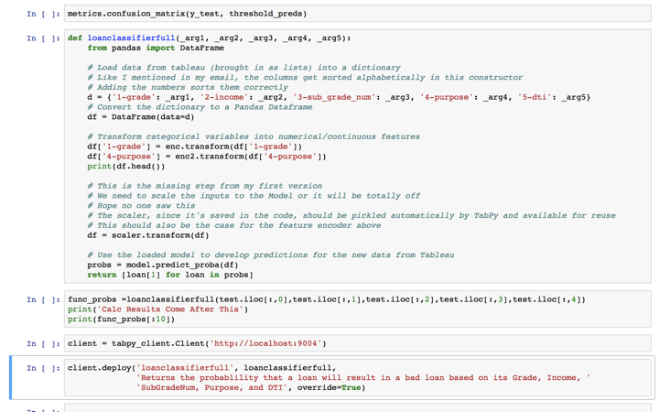
Publishing from Jupyter

Slide 23
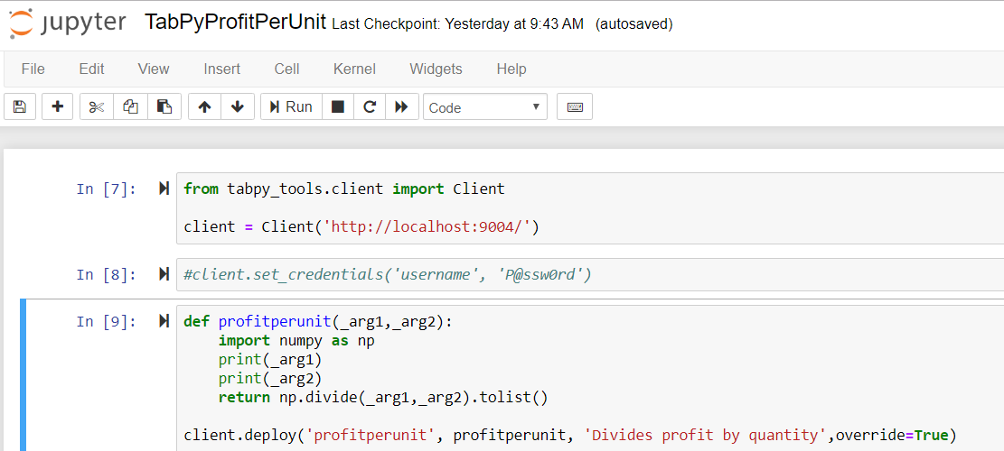
Exercise: Publishing a function to TabPy Server

Slide 24
Exercise: Calling Functions Published to TabPy Server
SCRIPT_REAL("
return tabpy.query('profitperunit',_arg1,_arg2)['response']",
SUM([Profit]),SUM([Quantity]))

Slide 25
Tableau Server Considerations

Slide 26
TabPy Integration on Tableau Server
Tableau Server Administrator uses TSM to configure
It is possible to configure SSL security for TabPy
For each workbook, Python and R are mutually exclusive
Tableau Online and Tableau Public do not support R/Python scripts
C:\> tsm security vizql-extsvc-ssl enable
--connection-type "tabpy"
--extsvc-host "<your Tableau server name or address>"
--extsvc-port "<port number on which it is listening>”
--connect-timeout-ms "1500" --script-disabled "true"
C:\> tsm configuration set -k vizqlserver.allow_insecure_scripts -v true
C:\> tsm pending-changes apply
Notes:
https://help.tableau.com/current/server/en-us/config_r_tabpy.htm

Slide 27
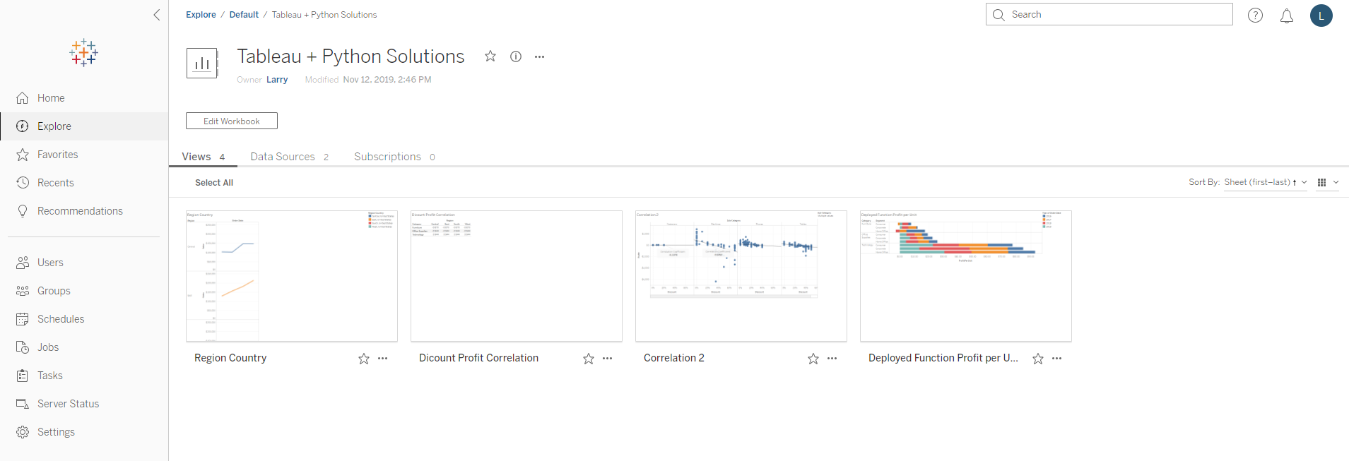
TabPy Integration on Tableau Server
Notes:
https://help.tableau.com/current/server/en-us/config_r_tabpy.htm

Slide 28
Tableau Prep Conductor + Python

Slide 29
Why use TabPy with Tableau Prep?
A Tableau Desktop calculated field using TabPy is a Tableau table calculation. This creates some limitations:
Script only runs when in a view
Can not build on R/Python calculations unless they are in the view
Large datasets can mean long wait times
R/Python based calculations not included in extracts
Running the Python script as part of a Prep flow solves each of these problems.

Slide 30
Connecting Tableau Prep to TabPy

Slide 31
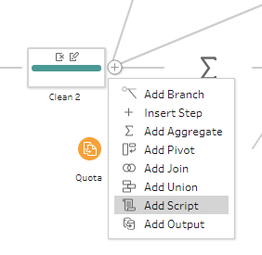
Add a Script step to Tableau Prep

Slide 32
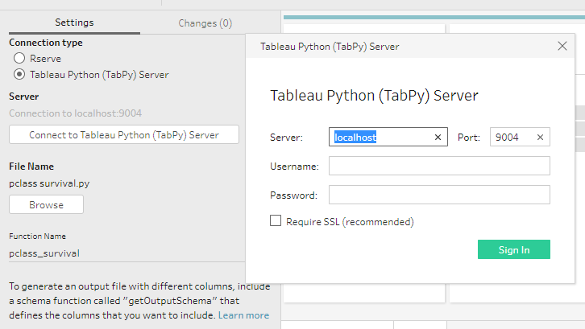
Configure the Script step
Connection Type
Server
File Name
Function

Slide 33
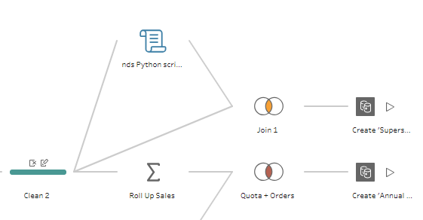
Incorporate the script output into your Flow

Slide 34
Resources

Slide 35
Resources
Working with External Services in Tableau: Python, R, and MATLAB
TabPy on Github
Tableau Integration with Python Step by Step

Slide 36
Tableau + Python = ❤
11/13 1:15 – Level 2 – Mandalay Bay J
11/14 1:15 – Level 2 – Mandalay Bay J
11/15 10:30 – Level 2 – North Convention Center – Islander G
11/15 1:15 – Level 2 – Mandalay Bay J

Slide 37
R…You Ready for Python? (BYO Laptop)
The Forecast Looks Bright: Tableau Forecasting
From 'Hello World' to Saving the World: Advanced Analytics with Python

Slide 38
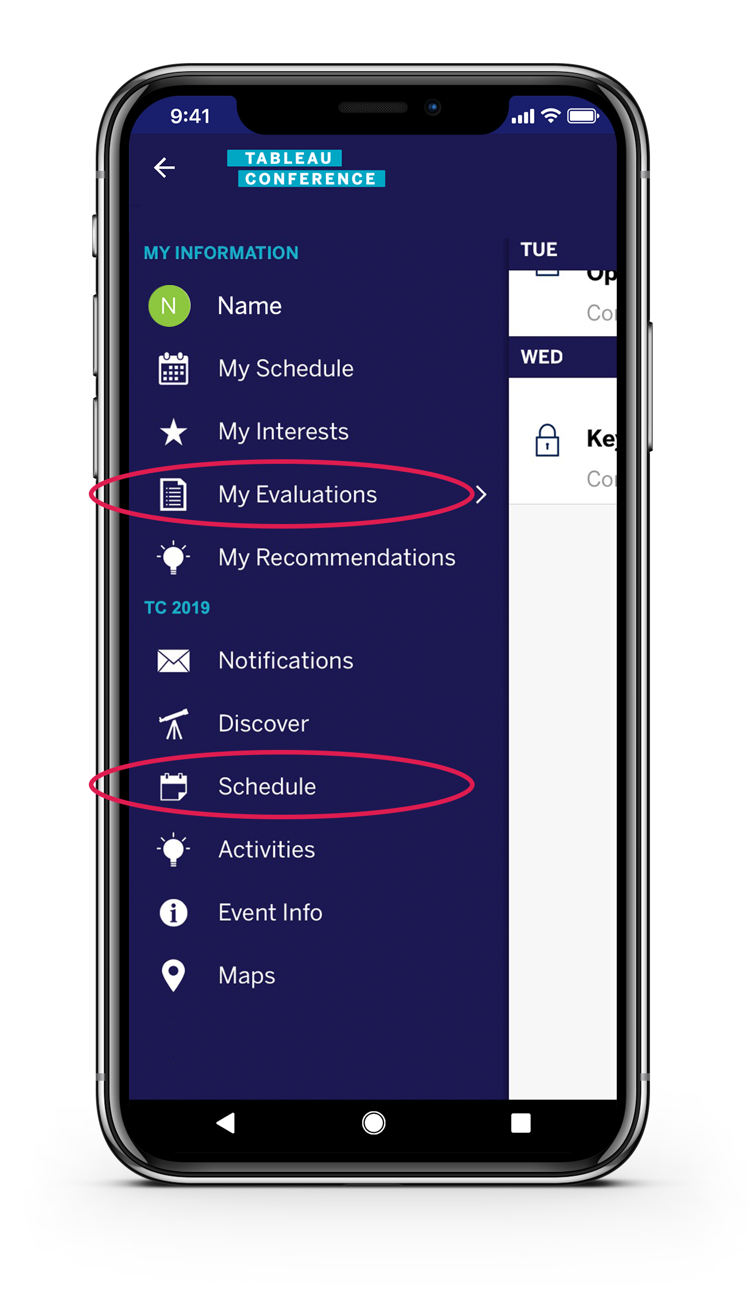
View ‘My Evaluations’ in the menu or find your session under ‘Schedule’
Please complete the session survey in the mobile app

Slide 39
Thank You

